Slide 1

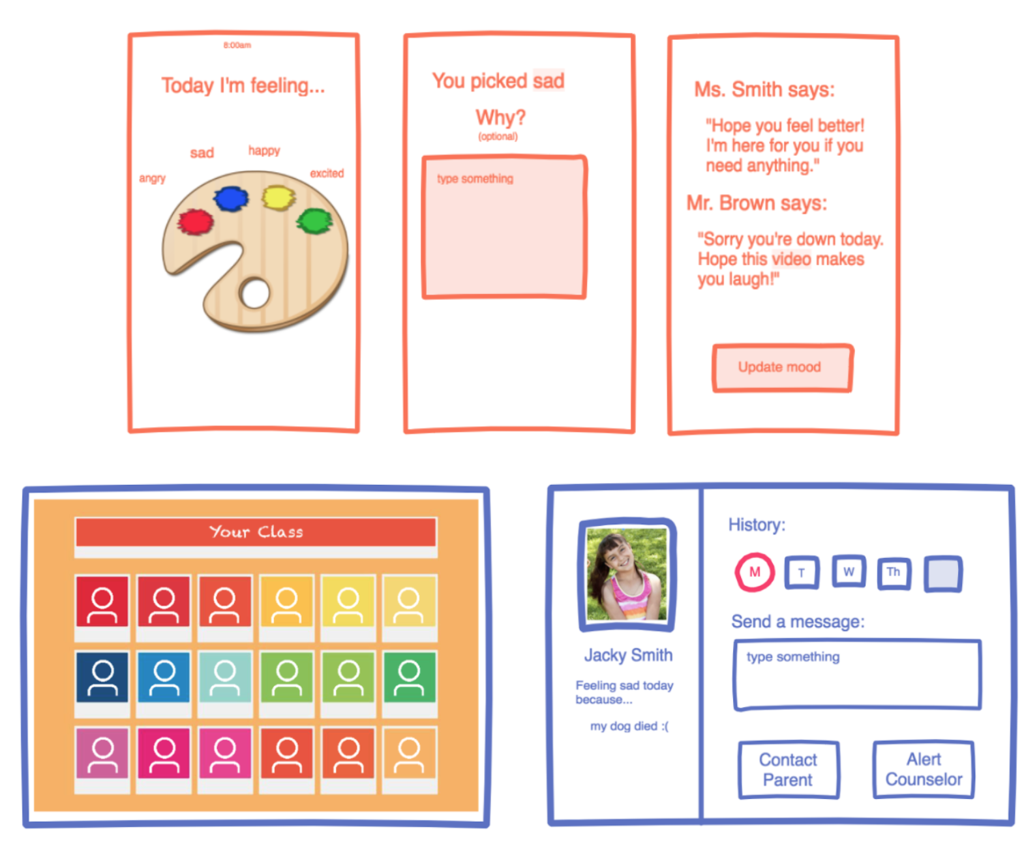
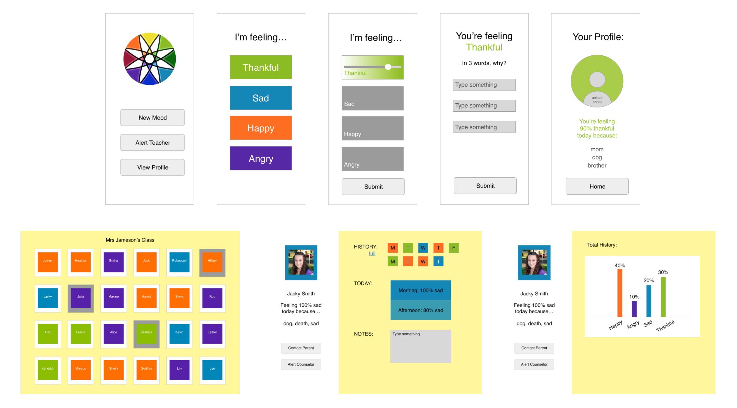
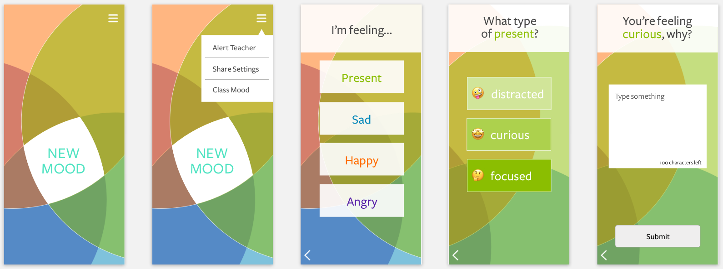
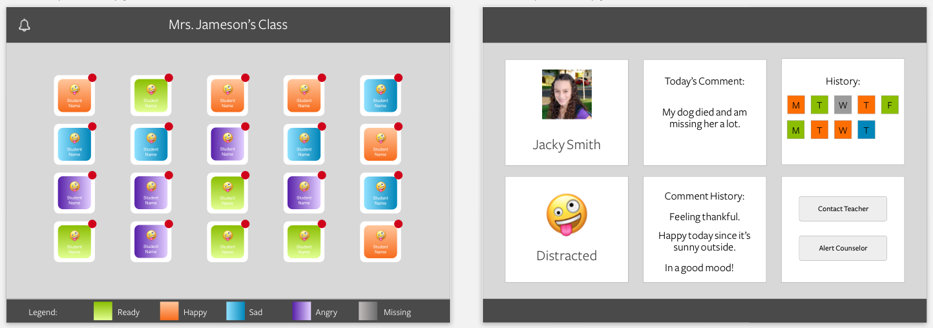
Spectra: An App to Improve Teacher Student Relationships
CS179 Alice Huang, Kevin Yoon, Rob Waddilove
Needfinding
Concepts
Problem Definition
We conducted contextual inquiry at Putnam Upper Middle School through visiting ~10 classrooms and interviewing teachers. Below are some main insights:
Extroverted children get more attention than shy children in the classroom.
Relationships between students and teachers affect student performance.
Product Concept 1: Interactive platform for students to share their emotions with their teachers.
Product Concept 2: Online platform where guidance counselors can understand the anonymous questions students are interested in knowing more about.
After user feedback, we decided to pursue product concept 1 because it was low lift and solved a real need in the classroom.
Problem: Teachers don’t have time to build relationships with students.
Target Audience: Middle school teachers and students
Teaching teams (same group of teachers for same group of kids) makes it easier to develop relationships
Average age for first mobile device is 12 years old
Prototypes
1. Mock-Up
2. Wireframes
3. Final Screens
Figure 1 (top): Student UI mock-up
Figure 2 (bottom): Teacher UI mock-up
Figure 1 (top): Student UI wireframe
Figure 2 (bottom): Teacher UI wireframe
Figure 1 (top): Student UI final prototype
Figure 2 (bottom): Teacher UI final prototype
Feedback
Interviews
“Wizard of Oz” Testing
User Testing
It would also be helpful if there were multiple choice options for reasons to pick 3 words instead of writing paragraphs. That way, it’s easier for teachers to read and students will be more willing to input more information.
~ middle school STEM teacher
Wireframes have the three word responses instead of the open paragraph text box.
“What happens if I don’t want my math teacher how I am feeling today because I don’t feel close enough to share with him/her? We should be able to control which teachers access our information!
~ 8th grader
Share settings feature. Now, students can select the teachers to share their feelings with.
“I feel like our teachers would show us more mercy if they saw this”
~ 7th grader
Students understood the general purpose of the app and how teachers and students should have better relationships.
Teachers “don’t have downtime” and thus would find it difficult to respond to children in real time. I would feel bad simply giving “canned responses” to kids who were struggling, but I wouldn’t have the time to write anything longer.
~ high school CS teacher
The last screen where teachers responded to students’ quotes were eliminated. Instead, students could request meetings.
“How do I choose just three words to describe my mood!”
~ 7th grader
Instead of limiting it to 3 words, we chose to use a 100 character text box instead.
“There could be more moods like confident, nervous, jealous, anxious”
“Yes especially nervous… that’s a common feeling”
~two 7th graders
Students want more options for moods in the app. One potential solution is having a blank word box for customizing your feeling.
How can I monitor resolved issues so that I can keep track of which students I’ve met with already?
~ high school CS teacher
Teachers now can see a list of requested meetings by clicking on the bell icon on their main page.
“To try and bolster relationships, I would ask myself ‘Who haven’t I talked to this week?’ It would be a good week if I could talk to all 30 students by the end of the week.” “I like this because I could take 10 seconds and know where the kids are at.
~ middle school STEM teacher
Overall positive feedback from teachers showed us this product concept was the right one to choose.
“Imagine if teachers did this and we could see what they say”
~7th grader
Students were curious about their teachers moods as well.
“What did these colors mean again?”
~ middle school English teacher
We added a color legend to the bottom of the home teacher screen.
This presentation poster was based on a designed FPPT.
Notes:
You can add your presentation notes here. This presentation template for research posters is fully editable so text, graphics and content can be updated to fit your own research needs.
Download more poster presentation templates from FPPT.com

